Slide 1
SQL PROJECT
HealthCare Appointment Scheduling System
Project by
Hariharan D 29/11/2024

Slide 2
Introduction
Overview of the Healthcare Appointment Scheduling System
Purpose: Streamline the process of scheduling appointments with healthcare professionals.
Users: Patients, Doctors, Receptionists, Admin.
Benefits: Improved efficiency, reduced waiting times, better resource management.

Slide 3
Main Objectives:
To create a system for managing patient appointments.
To store and manage patient, doctor, and appointment data.
To provide an interface for users to book, update, and cancel appointments.
To generate reports for doctors and administrators.

Slide 4
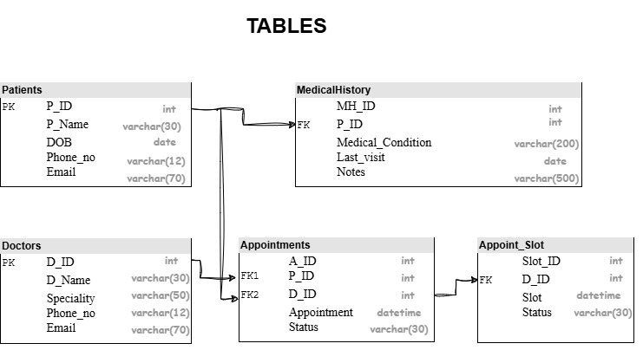
tables

Slide 5
Entities and Attributes
1. Patients
P_ID: Unique identifier for each patient.
P_Name: Patient's name.
DOB: Date of birth.
Phone_no: Contact phone number.
Email: Email address.
2. MedicalHistory
MH_ID: Unique identifier for each medical history record.
P_ID: References the patient ID.
Medical_Condition: Medical condition of the patient.
Last_visit: Date of the patient's last visit.
Notes: Additional notes on the patient's condition.

Slide 6
3.Doctors
D_ID: Unique identifier for each doctor.
D_Name: Doctor's name.
Speciality: Doctor's medical specialty.
Phone_no: Contact phone number.
Email: Email address.
4. Appointments
A_ID: Unique identifier for each appointment.
P_ID: References the patient ID.
D_ID: References the doctor ID.
Appointment: Date and time of the appointment.
Status: Status of the appointment.
5. Appoint_Slot
Slot_ID: Unique identifier for each appointment slot.
D_ID: References the doctor ID.
Slot: Date and time of the appointment slot.
Status: Status of the slot.

Slide 7
Conclusion:
Successfully created a healthcare appointment scheduling system.
The system optimizes patient appointment management and improves communication between patients and doctors.
--------------------------***--------------------------

